Slide 1
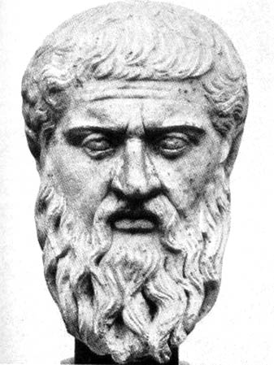
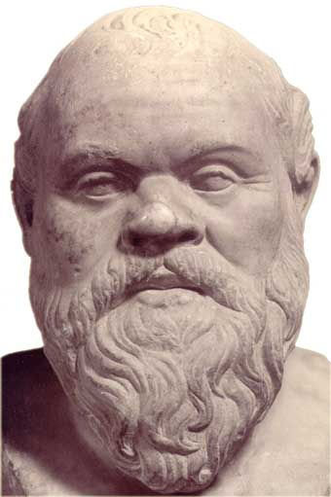
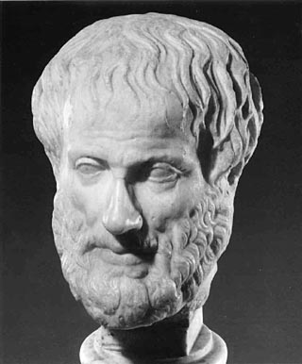
Greek Achievements
Plato
Key Terms
Socrates
Plato
Aristotle
reason
Euclid
Hippocrates
Socrates
The Big Idea : Ancient Greeks made lasting contributions in the
Arts, philosophy, and science.
Aristotle

Slide 2
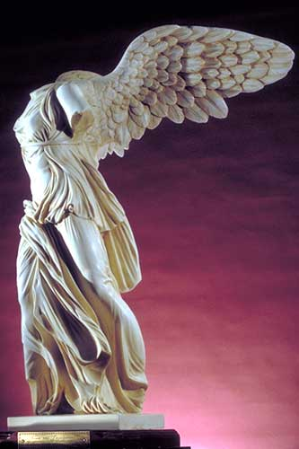
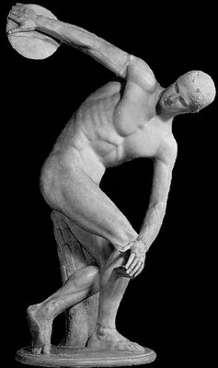
The Arts : Statues
Greek sculpture
is admired for
its realism
and details.
Greeks were master artists.
They were so good because they paid attention to fine detail.
They also studied the human body.
Many of their sculptures looked like they could come to life.
Statues were
made of
stone or
marble.

Slide 3
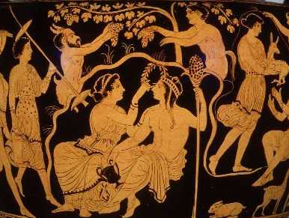
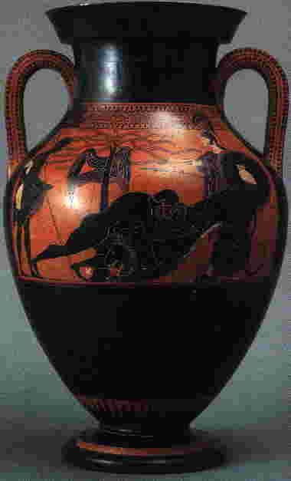
The Arts : Paintings
Greek paintings are also admired for their detail.
Many of the painted scenes show athletics or scenes from myths.
Scenes were usually done in red and black.

Slide 4
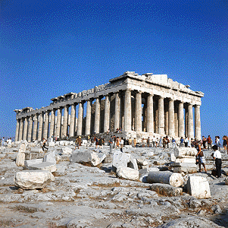
The Arts : Architecture
The Greeks took great care in designing their buildings.
They wanted their buildings to be a reflection of their city.
The pillars of the Greek temples appear perfectly straight. Greeks understood that in order
for pillars to appear to be straight, they needed to actually be wider in the middle.

Slide 5
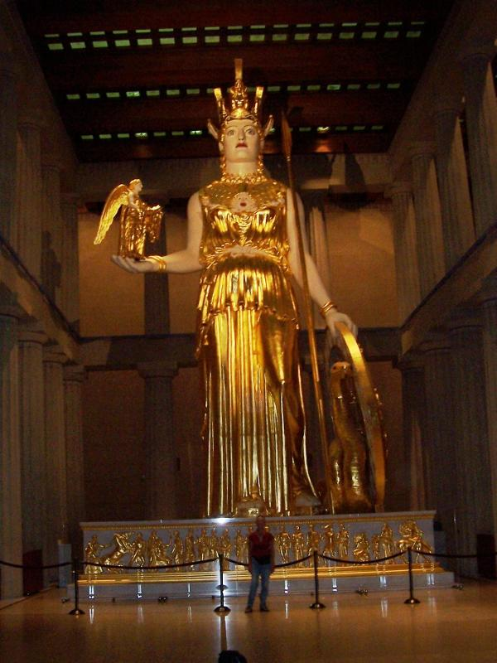
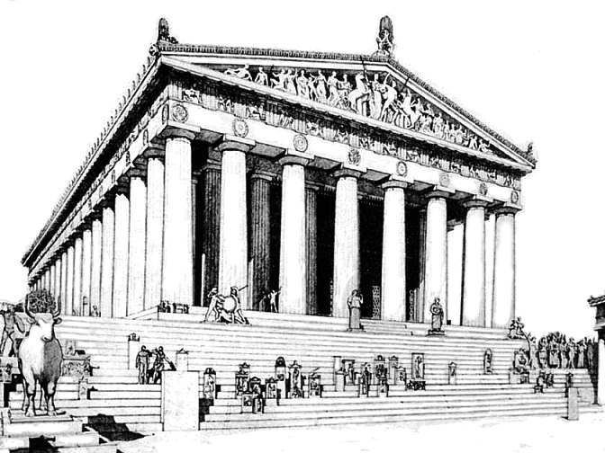
The Parthenon
Inside the Parthenon stood a statue of Athena.
The Parthenon was
built by Pericles
for Athena, the
protector of Athens.
The Parthenon
has 46 columns.In
Once a year, the people of Athens held a
festival in honor of Athena.

Slide 6
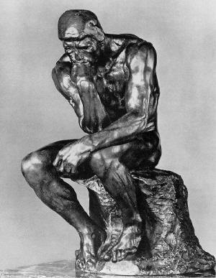
Philosophy
Socrates
Plato
People began to question gods as the reason for life being the way it was.
These people who questioned life were called philosophers.
Philosophers believed in the power of the human mind the think and explain.
Aristotle

Slide 7
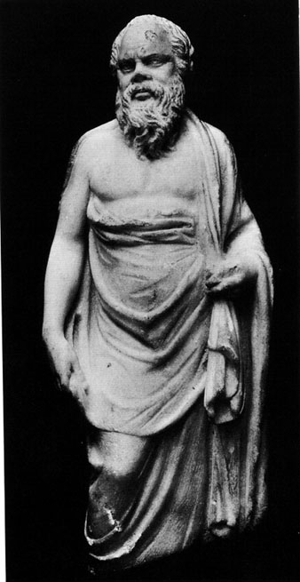
Socrates
At his death, his
students watched
him calmly take
the poison and die.
“What is love?”
“What is courage?”
Socrates believed people should never stop looking for knowledge.
He was a teacher who taught people to ask questions of life.
He frustrated many and was accused of questioning the gods and corrupting youth.
For questioning the gods, he was condemned to death.

Slide 8
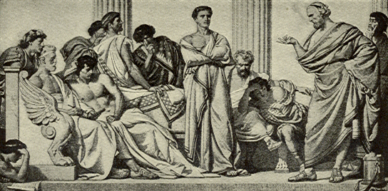
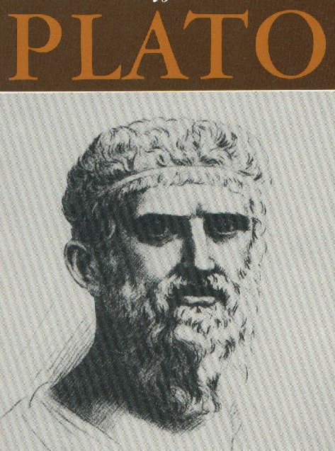
Plato
The Republic discussed
the ideal society based
on justice and fairness.
Plato was Socrates’ student.
Plato also taught along with being a philosopher.
Plato had a famous school for philosophers and scientist to come and discuss ideas.
Plato wrote a famous philosophy work, The Republic.
I believed
philosophers should
rule because
only we understand
what was best.

Slide 9
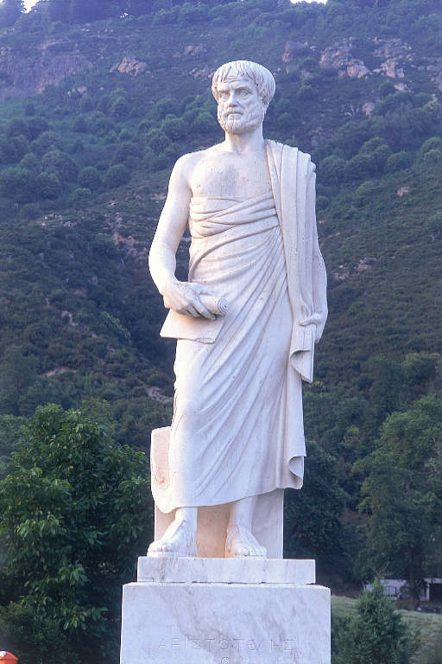
Aristotle
Aristotle, Plato’s student,
was the greatest thinker in
Greece.
Aristotle was
against greed
but felt like
you shouldn’t
give away
everything you
own.
He believed in moderation, or finding a balance in life.
He believed moderation was based on reason, or clear and ordered thinking.
He believed people should think about the actions before doing them and predict how they will affect others.
Aristotle was a master at logic, the process of making
inferences. For example, if you know Socrates lived
in Athens, and Athens is in Greece, Socrates must live
in Greece and possibly be Athenian.

Slide 10
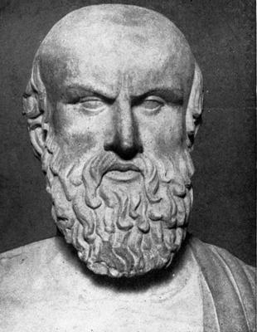
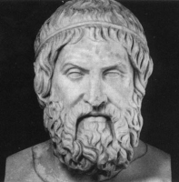
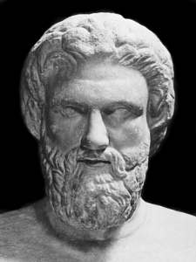
The Arts : Writing
Greeks also began recording history by writing
about it. They tried to write neutral accounts of what happened in Greece.
Aeschylus
and Sophocles
were among the
best tragedy
writers.
Greeks created drama and historical writing.
Their writing was a large source of entertainment.
They performed tragedies and comedies, writing about wars and bringing light to them.
Aristophanes
was a famous
comedy
writer.

Slide 11
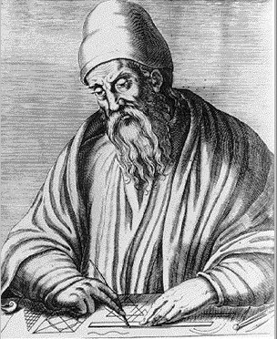
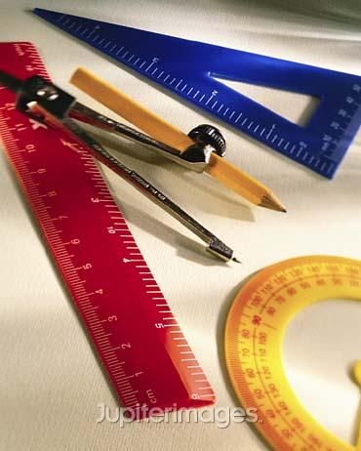
Math in Ancient Greece
The study of flat shapes and lines is called Euclidean geometry.
With math,
the Greeks
were able
to measure
the size of
Earth.
Some Greeks spent their lives studying math.
Euclid (YOO-kluhd) was one of these people, and many geometry rules we study today come from his studies.
Hypatia (hy-PAY-shuh) was another famous, Greek
Mathematician. She devoted her life to teaching her findings
to others.

Slide 12
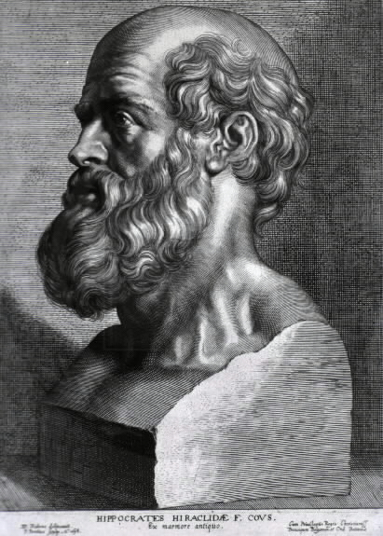
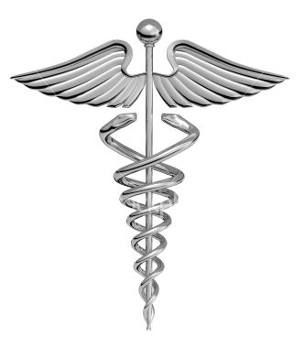
Medicine in Ancient Greece
Greeks also studied medicine.
They studied the human body and how it worked.
They tried to cure diseases and keep people healthy.
Hippocrates (hip-AHK-ruh-teez) was a great Greek doctor who studied what caused disease.
Today, Hippocrates is known for his ideas about how doctors should
behave. When doctors graduate medical school, the recite the Hippocratic oath.

